Slide 1
ANALYSIS OF CLIMATE CHANGE IMPACT TO GLOBAL WINE PRODUCTION

Slide 2
UCB Data Bootcamp Project 1
June 17th, 2024
Brenda M., Theresa F., Rinal S., Jeff K., Madison O.

Slide 3

Research questions
Which were the top wine producing countries in year X?
Which are the current top wine producing countries in year Y?
What is the correlation between temperature and wine production?

Slide 4
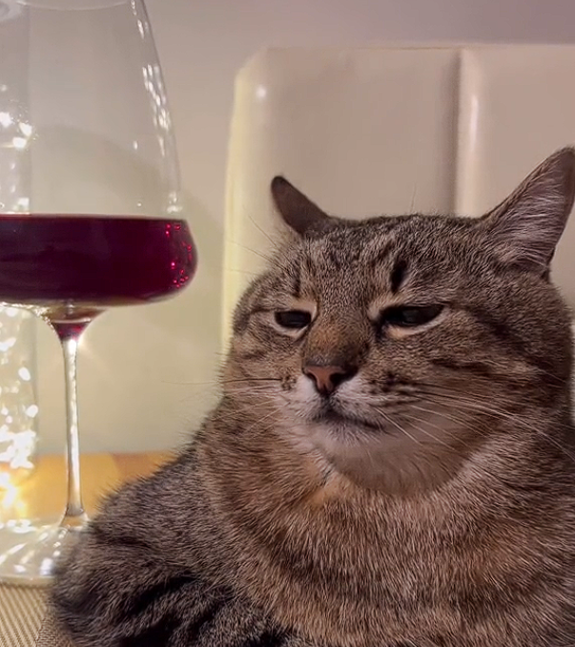
Research questions cont.
What is the correlation between precipitation and wine production?
What is the optimal temperature for maximum production?
What is the optimal precipitation level for maximum wine production?
For which countries has the climate changed to favorably or unfavorably impact wine production?

Slide 5
DATASETS
International Organization of Vine and Wine
Statistics https://www.oiv.int/what-we-do/statistics
Database Discovery Tool https://www.oiv.int/what-we-do/data-discovery-report?oiv
NOAA National Centers for Environmental Information
Data access https://www.ncei.noaa.gov/access
NCEI Data Service API User Documentation https://www.ncei.noaa.gov/support/access-data-service-api-user-documentation
Climate Data Online: Web Services Documentation https://www.ncdc.noaa.gov/cdo-web/webservices/v2#gettingStarted

Slide 6
Discussion & findings

Slide 7
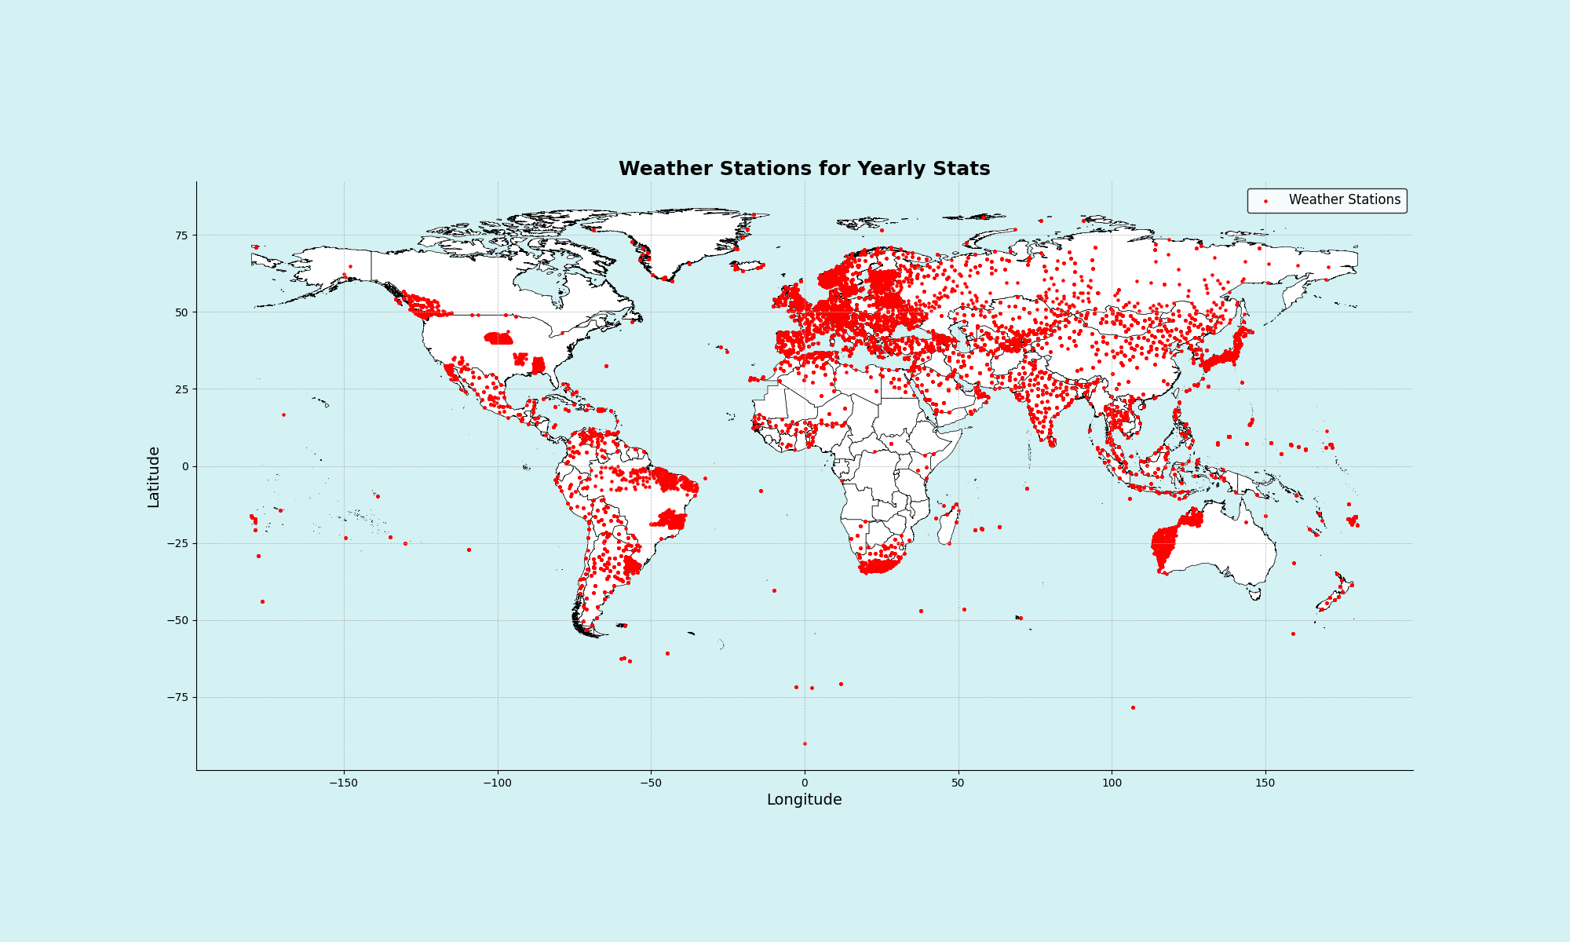
[INSERT]
…

Slide 8
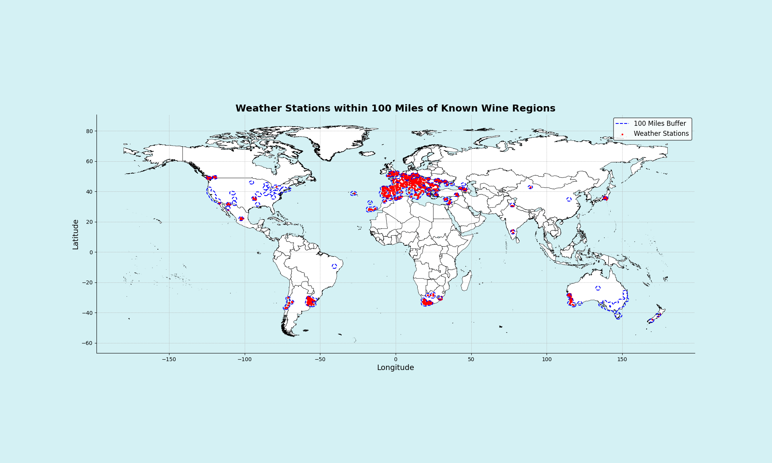
[INSERT]
…

Slide 9
Work
Cleaned up wine_data_all_2.csv to match country names with weather data
NOAA weather data used FIPS-10 system of country codes. I prepared the fips-countries.csv
To observe weather affects on wine production created plots to observe affect on production per different parameters like PRCP, TMAX, EMXT, etc.
Plotted correlation between TMAX and Wine production taking France as an example.
The correlation is calculated using the lingress function
The lines and slopes show that production falls as temperature rises

Slide 10
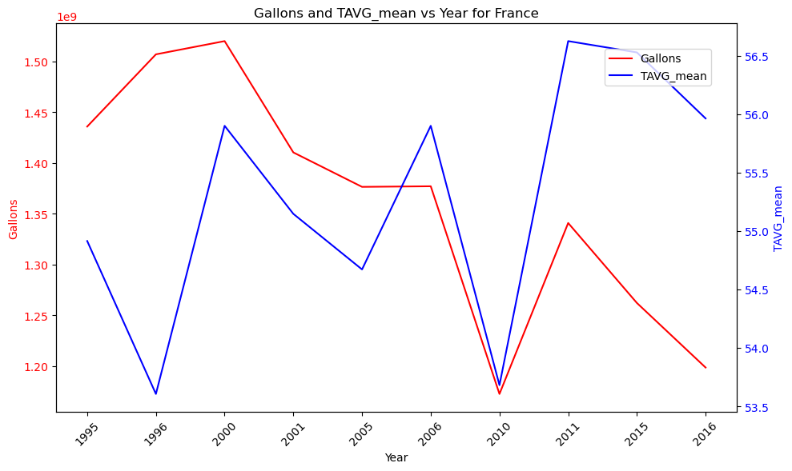
Changes in wine production per weather Taking France as an example
Average Temperature

Slide 11
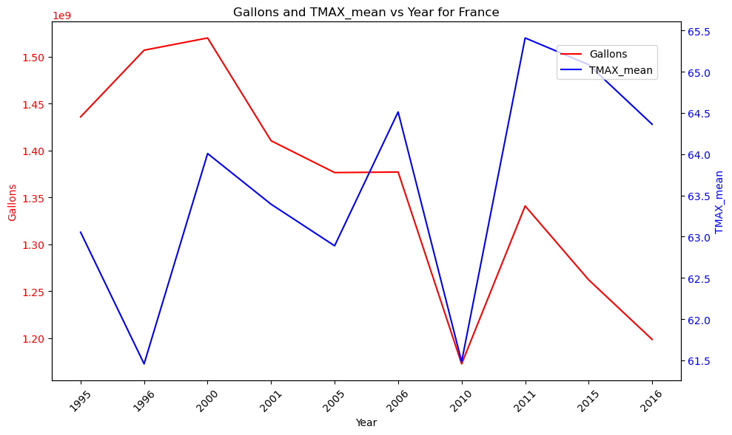
Changes in wine production per weather
Max Temperature

Slide 12
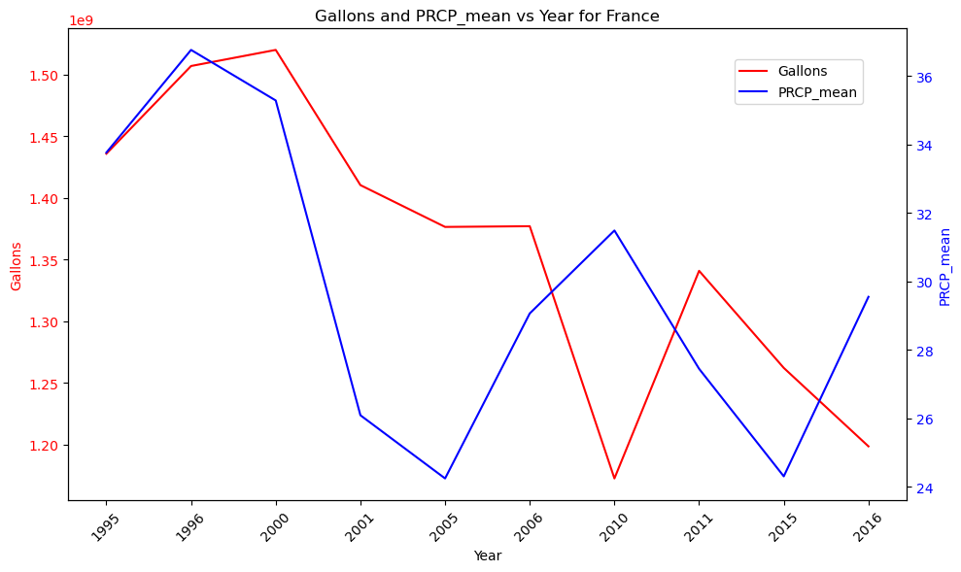
Changes in wine production per weather
Precipitation

Slide 13
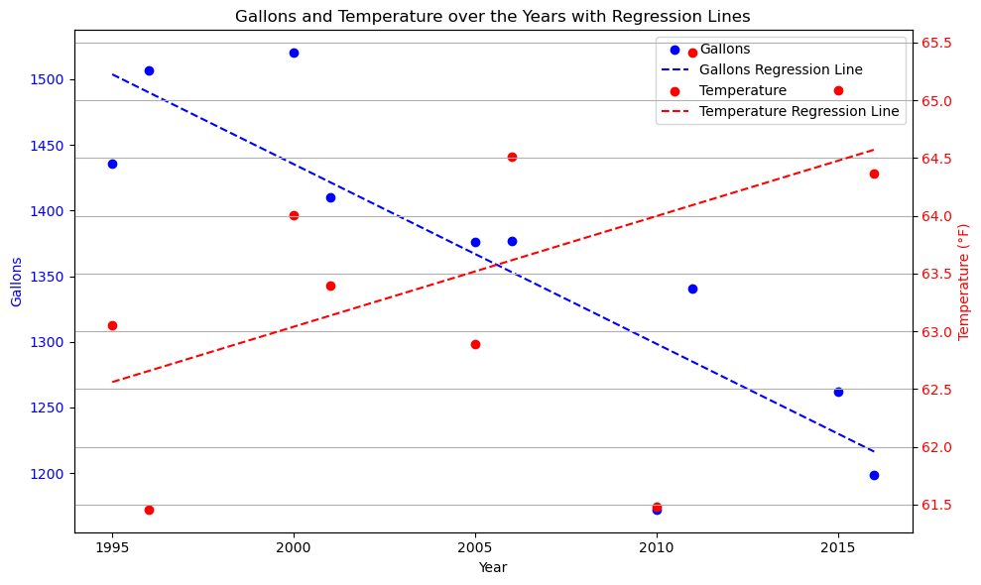
Correlation between Temperature and production
Over the years correlation between temperature and Production

Slide 14
Findings
Most wine producing countries have colder climate
The correlation shows that wine production has suffered as Temperature increased
Problems:
Over the years technology has also improved increasing wine production.
This is unaccounted for in the temperature/production analysis
Lot of countries wine production does not show proper relationships

Slide 15
[INSERT]
19XX: …
20XX: …
20XX: …

Slide 16
overview
20XX
20XX
20XX
20XX

Slide 17
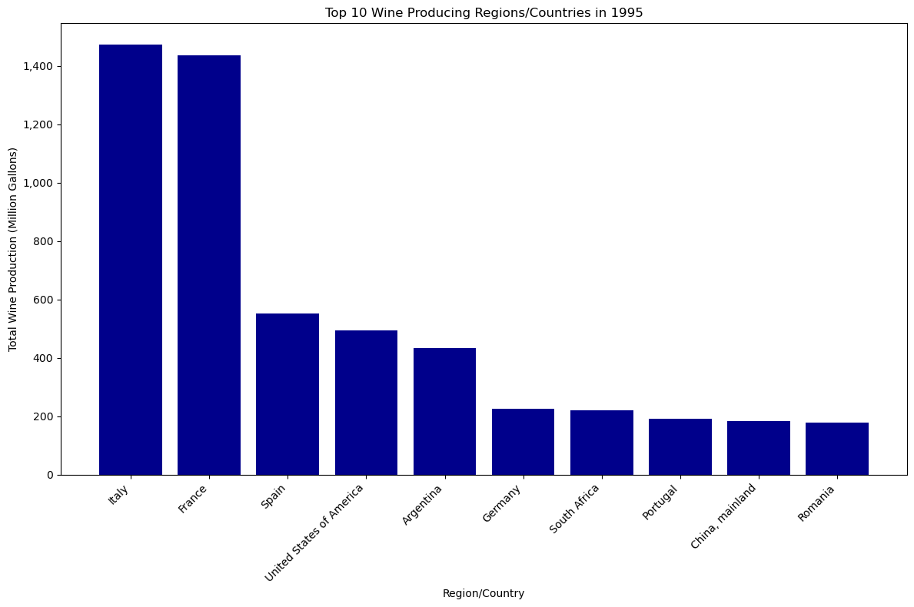
Summary
Top wine producing countries in 1995
Climate has a direct influence on grape crop development and the final yield. Hence why this analysis focused solely on climatic factors and their change over time.
Analysis range for total global wine production 1995 – 2023.
1995: ~6,000 million gallons
2023: ~4,000 million gallons
Focused in the mediterranean region

Slide 18
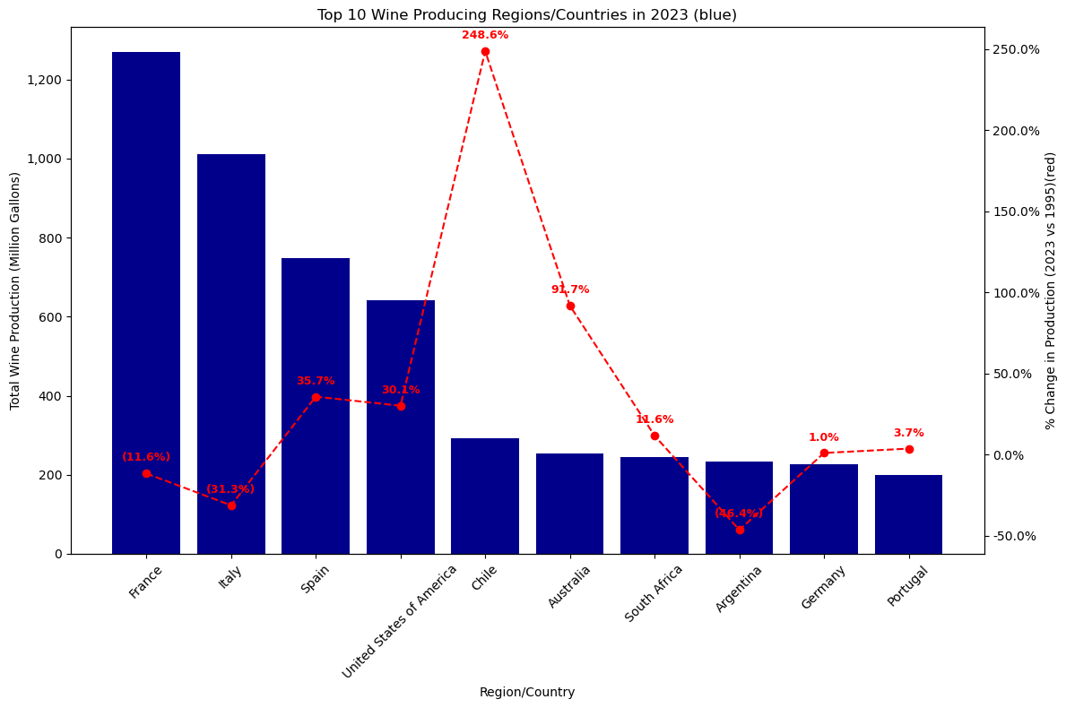
Summary continued
Top wine producing countries in 2023

Slide 19
References & resources

Slide 20

Thank you!
Q&A

